Slide 1
SHOEBOX
GROUP - 21

Slide 2
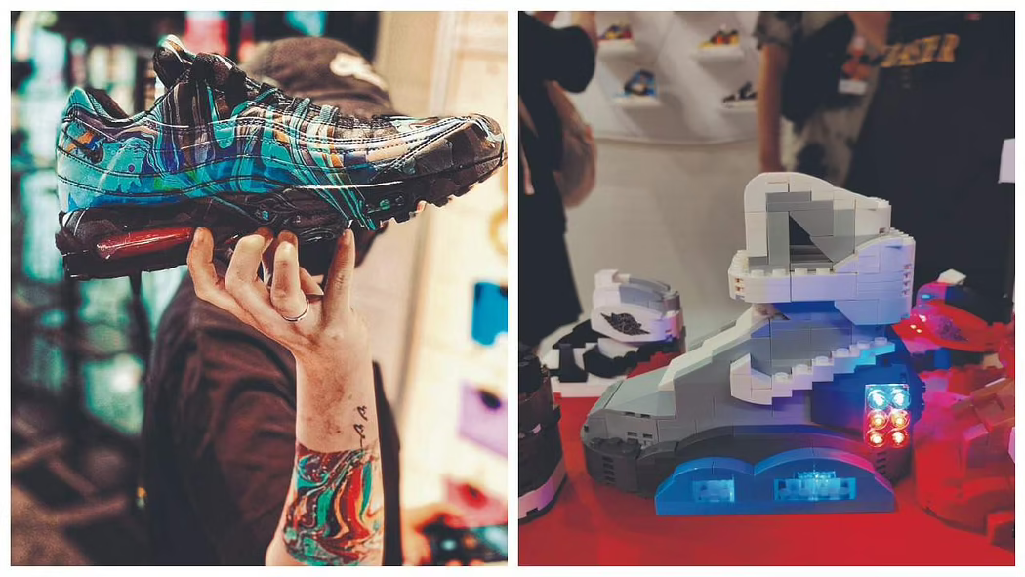
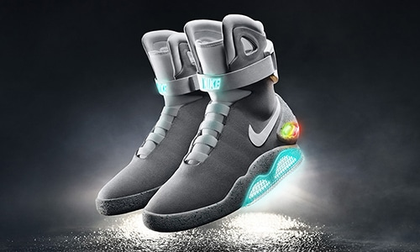
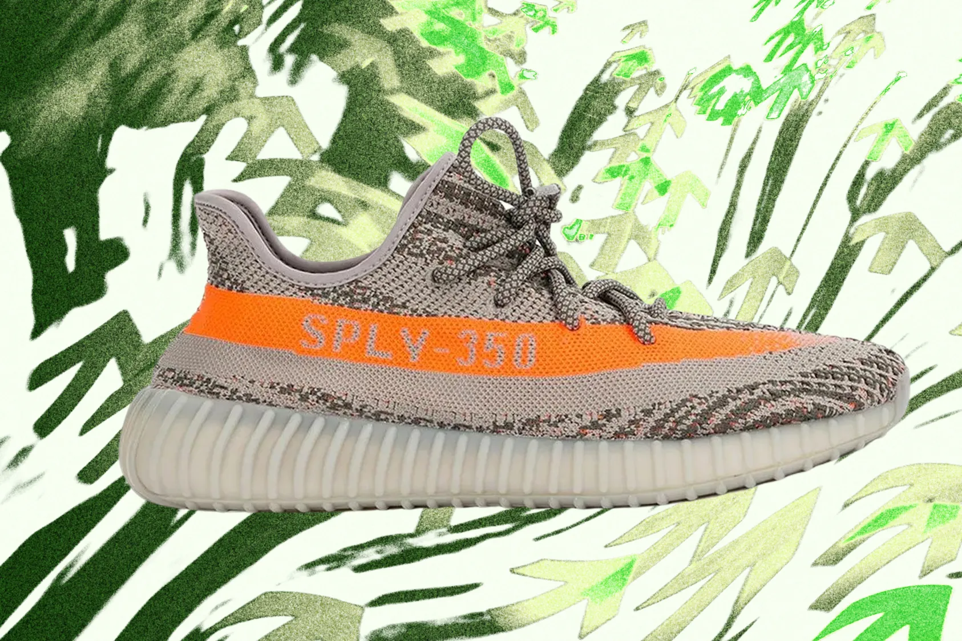
Motivation
Fashion is indeed one of the things that people give value to and put effort on. It has become a part of the modern culture and lifestyle. There have been waves of fashion trends but shoes have always been a constant. May it be the brand, the athlete that wears it, the celebrity that owns it or even the nostalgic side of it. Recent years have seen shoes become a collective with the interest in brands at a peak.
What Makes People Buy Shoes Even When They're Expensive? ShoeBox will give sneakerheads add a social media experience to buying shoes. A user can stay up-to-date on new releases from the brands they follow, collectives and special editions on our web app.

Slide 3
PROBLEM STATEMENT
To create an ecommerce web app with social media features where users can follow brands and explore trending shoes
Detailed description and hype around each shoe
One should be able find all types of footwear from all brands across the globe at one place with necessary filters and options.
To create a very simple and safe platform for selecting, designing and buying footwears.
Allow interaction and discussion between users and brands and among users

Slide 4
PROBLEM SOLUTION & DESCRIPTION
The web app has three main parts,
Products module
User module
Orders module
The products module will contain the details about the products, price, image, product id etc in a database table and pagination with filtering and search operations.
The users can simply login and register using google credentials. The user module will contain the database of the user login record, user transactions, order id, wishlisted items, etc.
The order module will contain the list of orders with there payment, shipment, track order, product id details for the convenience of user and the admin.

Slide 5
TASK PLAN
Week 1 - Home Page, Navigation Bar
Week 2 - Cart, Order Confirmation
Week 3 - Item Review, Additional social media Functions
Week 4 - Google Auth Login, Pagination
Week 5 - Likes, Follow, Brand Pages, Filtering, Pagination
Week 6 - Customization, Track order, Customer Service Page

Slide 6
SOFTWARE COMPONENTS
React Js
Redux
CSS
HTML
SQLITE3
JSON Server
Google Auth Login
Payment Gateway API

Slide 7
PROJECT TIMELINE
MID REVIEW Complete Task Details, Home Page, Cart, Item Review, Checkout Form , Payment Section and Project Synopsis
FINAL REVIEW Google Auth Login, About Us Page, Track order, Payment
Gateway, Liked, Following Brands, Customer Help Page,
Shoe customization, Dry run of website

Slide 8
OUR TEAM
NAME | ROLL NO | MAIL ID | TASK
S SURYAVARDAN | S20190010154 | suryavardan.s19@iiits.in | Cart, Checkout and Payment confirmation, Documentation
PIYUSH KUMAR | S20190010141 | piyush.k19@iiits.in | Item Review, Styling, PPT
HIMESH KUMAR | S20190010065 | himesh.k19@iiits.in | JSON Server, Item review
ANURAG KUMAR | S20190010101 | chaitanya.k19@iiits.in | NavBar, Footer
CHAITANYA ANAND KOPOORI | S20190010009 | anurag.k19@iiits.in | Home Page, Wireframe

Slide 9
REFERENCES & CREDITS
www.reactjs.org
www.nodejs.org
www.shoebk.com
www.nike.com
DevEd
FSD Course Material

Slide 10
“Good Shoes Take You Good Places.”
- From Edward Stalin

Slide 11

Thank You
GROUP - 21
IIIT, SRI CITY
suryavardan.s19@iiits.in

